Slide 1

Welcome to arcade games paradise
the games website project
Yash mehta
Vishal kokane

Slide 2
introduction
This project is aimed at developing a website for online gaming. It provides the users more pleasure and gladdening his mind by playing these retro-traditional games Arcade Games Paradise is an online platform that allows users to play and interact with various types of games. Our project can feature a range of games such as action, strategy, adventure, puzzle, simulation, and sports games, among others. Arcade Games Paradise can offer a personalized user experience by allowing users to create and manage their accounts and track their gaming progress. Our goal is to provide users with a fun and engaging gaming experience that keeps them coming back for more

Slide 3
Existing System and Need for System
Existing system lacks in below points:
Website contains Ads, Paid games
Not all games at same place to play
Not all games on browser
High internet connection requires

Slide 4
Proposed system
Proposed system contains following points:
No ads in webpage
Free to play games
All your favorite games at one place
All Brower based games easy to access
Slow internet connection is necessary

Slide 5
Objectives of Proposed System
The project's objectives may include the following:
To provide a fun and engaging gaming experience that keeps users coming back for more.
To offer a personalized user experience that allows users to create and manage their accounts and track their gaming progress.
To offer a platform for game developers to showcase their games and gain exposure to a wider audience.
To provide a platform for advertisers to reach a highly engaged and targeted audience.

Slide 6
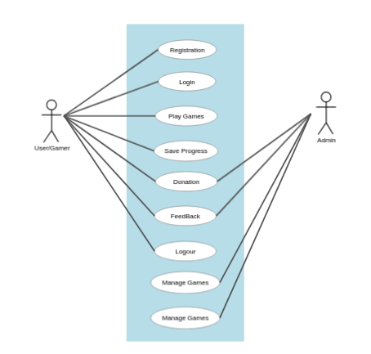
Design
Use case diagram :

Slide 7
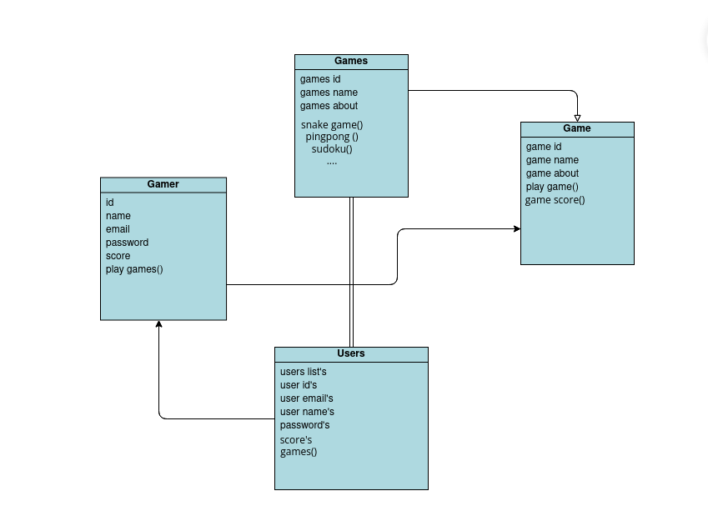
Class diagram :

Slide 8
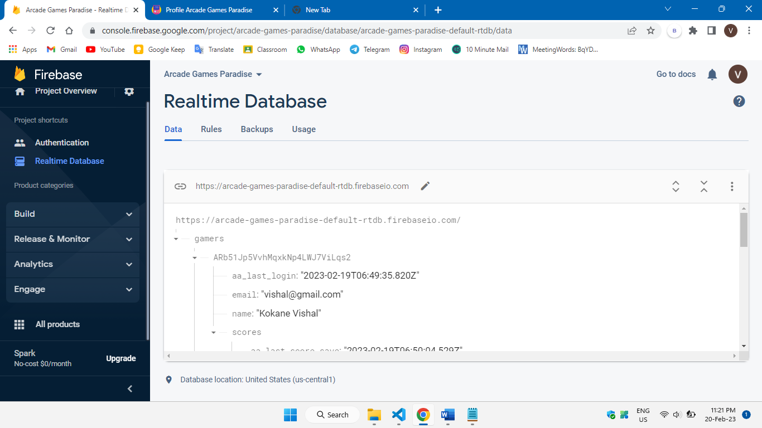
DATA-BASE

Slide 9
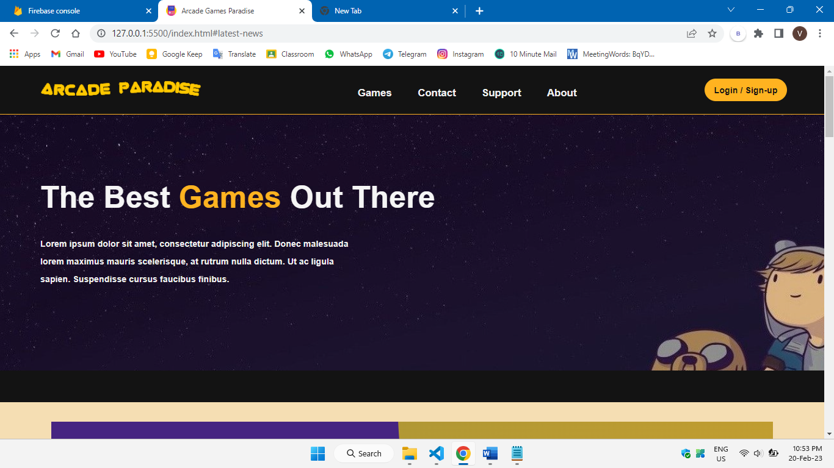
SCREENS
Home Page :

Slide 10
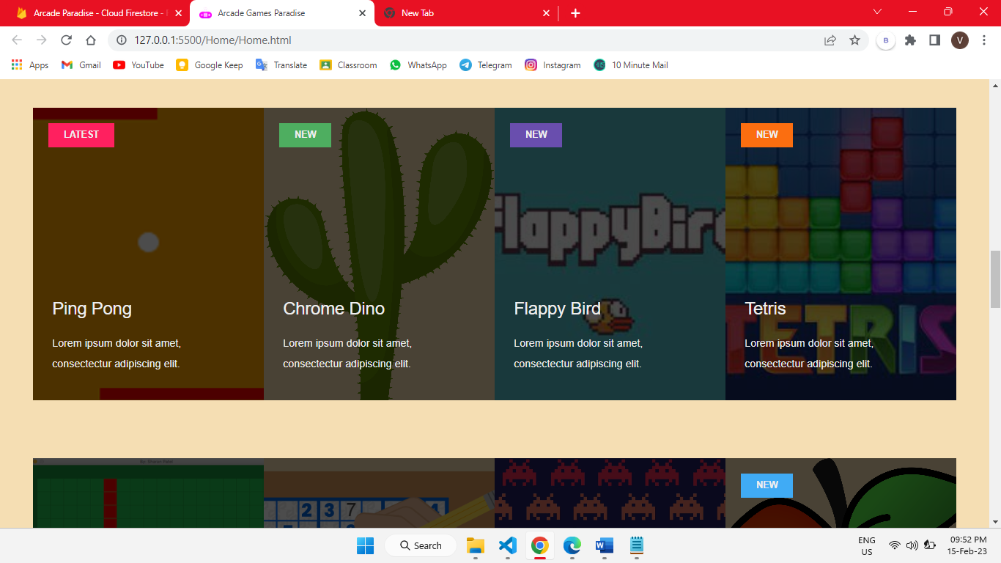
Games :

Slide 11
future Enhancements
Improved user experience: Enhancing the user experience can be accomplished by making the website more intuitive, visually appealing, and faster to load.
Mobile optimization: With the increasing popularity of mobile gaming, optimizing a game website for mobile devices can help attract a wider audience.
Social features: Adding social features such as chat rooms, leaderboards, and friend lists can enhance the sense of community and provide players with more ways to interact.
Gamification: Incorporating gamification elements such as achievements, badges, and points systems can add a layer of fun and motivation for players. Innovation: Developing multiplayer games requires creativity and innovation, which can attract new players and set a game website apart from competitors.

Slide 12
Conclusion
In conclusion, The Arcade Games paradise project has several advantages and disadvantages. This project can be great opportunity to showcase your creativity and programming skills while providing entertainment to user by Creating user friendly website with a selection of high-quality games and you can attract a large audience gaming and feedback. However, building and maintaining a successful game website can be technically challenging, resource-intensive, and competitive. Therefore, careful planning, investment, and ongoing effort are necessary to make a games website project successful. Overall, a game website project can be a rewarding venture for those with a passion for game design and the resources and commitment to build and maintain a high-quality website.

Slide 13
Thank you all !!!

